Slide 1
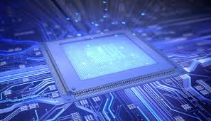

Malla Reddy Engineering College And Management Sciences Medhcal
WSN based Mobile and PC Control Room Environment for Industrial Applications
M.Tech Thesis Presentation
Presented By
Mr. Tirunagari Raghavendra
14UJ1D5520
Date: 28-12-2015

Slide 2

IT CONTAINS
Introduction
Hardware Components

Slide 3
INTRODUCTION
The use robotics is increasing day by day to replace the manpower for
many reasons and uses with high navigational intelligence.
The aim of developing a modern robot control system is to provide higher
flexibility with user transparent concepts for installation, programming
and operation of robots in their working environment.
In recent years there is a vast technology improvements in industrial
control rooms for monitoring the entire field of Industrial plants.
High end PLC’s are being implemented for controlling the entire
process of fields.

Slide 4
But a problem is that even though automation takes the complete
control of total plants few authentication and manual actions are
needed from user side for completing the control action.
Hence there is a must situation for users presence at all times in the
control room for taking some timely needed control actions.
Due to the static nature of control room environment, the user should
always be static to monitor the process.
The proposed system approach provides a good solution to this
problem.
The whole control room environment is additionally implemented in
the microcontroller platform and the same is communicated to the
process through GSM and ZigBee.

Slide 5
Now the user in control room can be mobile at anytime, anywhere to
monitor and control the whole plant.
At the same time the control parameters can be send to the desktop
computer.
A microcontroller board is used here for acquiring process control
parameters from the sensors and transmitting it via a GSM module to an
android device.
Hence the parameter values can be monitored and stored simultaneously.
The main objective of this proposed work is to acquire the level sensor
values with the help of microcontroller device.

Slide 6
Microcontroller device transmit the signals via GSM device interfaced with
controller and thereby monitoring and storing the process variable parameters
in a microcontroller platform..
We can monitor the industrial parameters such as gas, liquid level,
human detection, fire. If fire detected buzzer will on and a cooling fan
switched on.
If gas leaked buzzer will on. If liquid overflows buzzer will on. For
security purpose human detection sensor can be used. If any obstacle find
the robot will change the direction by using IR sensor.
All the parameters are send via GSM and ZigBee.
This project uses regulated 5V, 500mA power supply. 7805 three terminal
voltage regulator is used for voltage regulation. Bridge type full wave rectifier
is used to rectify the ac output of secondary of 230/12V step down transformer.

Slide 7
Hardware Components
LPC2148 ARM Microcontroller
GSM Module
ZigBee module
Fire Sensor
GAS Sensor
Level Sensor
PIR Sensor
IR Sensor
LCD Display
ULN2003 Relay Driver
Cooling Fan
PC
L293D Motor Driver
DC Motors
Voltage Regulator (7805)
Buzzer.

Slide 8
LPC2148 ARM Microcontroller
Features:
32-bit ARM7TDMI-S microcontroller.
40 kB of on-chip static RAM and 32 kB to 512 kB of on-chip flash memory.
In-System Programming/In-Application Programming (ISP/IAP)‏.
8 kB of on-chip RAM accessible to USB by DMA.
Two 10-bit ADCs provide a total of 14 analog inputs.
10-bit DAC provides variable analog output.
Two 32-bit timers/external event counters (with four capture and four compare
channels each)‏.

Slide 9
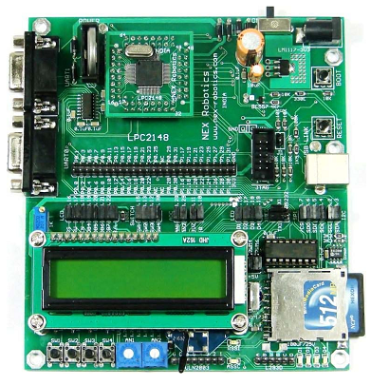
PWM unit (six outputs).
watchdog timer.
Real-Time Clock (RTC) with independent power.
Multiple serial interfaces including
-- two UARTs,
-- Two Fast I2C-bus (400 kbit/s),
-- SPI and SSP with buffering and variable data length capabilities.
Vectored Interrupt Controller (VIC) with configurable priorities and vector
addresses.
45 general purpose I/O pins.
21 external interrupt pins available.
On-chip integrated oscillator operates with an external crystal from 1 MHz to
25 MHz.
ARM 7 LPC2148

Slide 10
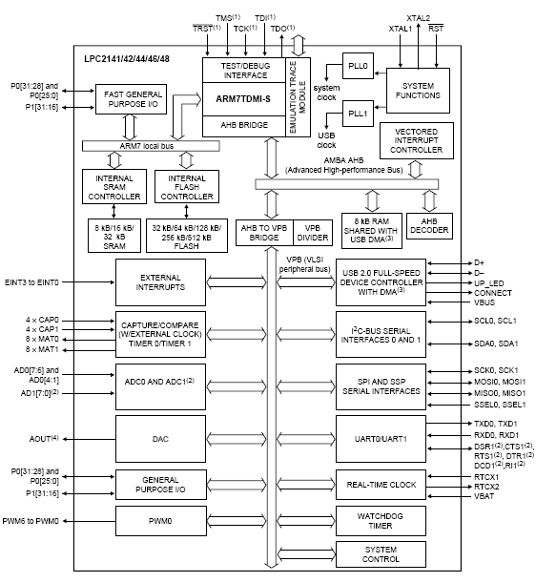
BLOCK DIAGRAM OF ARM 7 LPC2148

Slide 11
GSM MODULE
GSM Definition
-- GSM stands for Global System for Mobile Communications.
-- One of the leading digital cellular systems.
-- GSM was first introduced in 1991and as of the end of 1997;
GSM service was available in more than 100 countries and has
become the de standard in Europe and Asia.
-- GSM uses narrowband TDMA, which allows eight simultaneous
calls on the same radio frequency.
GSM Features
-- Compatibility that we can use the same mobile to make calls in
several countries.
-- Noise Robust such that digital GSM is better than analog
because it suffer from noise therefore using digital will reduce
the noise interference.
-- Flexibility and increased capacity due to equipment is smaller
in size.

Slide 12
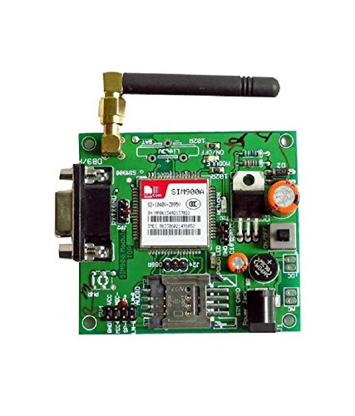
GSM Module
-- Any GSM module is using the normal GSM network.
-- GSM modules can be communicated to LPC2148- microcontroller
using normal serial USART protocol.
-- Communication is being done using regular GSM modem AT
commands.

Slide 13
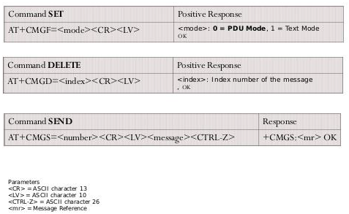
AT Commands, SMS

Slide 14
ZigBee MODULE
What is ZigBee?
-- ZigBee is a new wireless technology .
-- Technological Standard Created for Control and Sensor Networks.
-- Based on the IEEE 802.15.4 Standard.
-- Created by the ZigBee Alliance.
-- Philips, Motorola, Intel, HP are all members of the alliance.
-- Designed for low power consumption allowing batteries to
essentially last for ever.
-- ZigBee makes possible completely networked homes where all
devices are able to communicate and be controlled by a single unit.
-- It provides network, security and application support services
operating on the top of IEEE.
ZigBee Uses
-- It is used for embedded application for low data rates and Low
power consumption, In expensive.
-- Small packet networks.
-- Home Entertainment and Control.
-- Wireless sensor network’s.

Slide 15
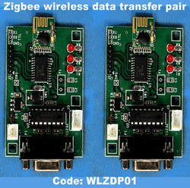
ZigBee Applications
-- The ZigBee Alliance targets applications Across consumer,
commercial, industrial and government markets worldwide.
-- Home networking.
-- Industrial control and management.
ZigBee Conclusion
-- In future all devices and their controls will be based on this standard. -- Since Wireless personal Area Networking applies not only to household
devices, but also to individualized office automation applications,
ZigBee is here to stay.
-- It is more than likely the basis of future home-networking solutions…

Slide 16
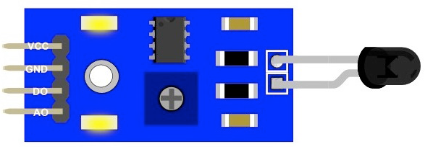
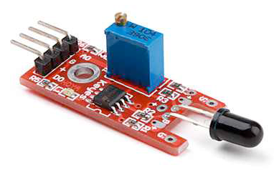
Fire Sensor
Introduction
-- Fire Sensor is also known has Flame Sensor Module.
-- This module is sensitive to the flame and radiation.
-- It also can detect ordinary light source in the range of a wavelength
760nm-1100 nm.
-- The detection distance is up to 100 cm.
-- The Flame sensor can output digital or analog signal.
-- It can be used as a flame alarm or in fire fighting robots.
Description
-- Detects a flame or a light source of a wavelength in the range of
760nm-1100 nm.
-- Detection distance: 20cm (4.8V) ~ 100cm (1V).
-- Detection angle about 60 degrees, it is sensitive to the flame spectrum.
-- Comparator chip LM393 makes module readings stable.
-- Adjustable detection range.
-- Operating voltage 3.3V-5V.
-- Digital and Analog Output
1. DO digital switch outputs (0 and 1)
2. AO analog voltage output
-- Power indicator and digital switch output indicator.

Slide 17
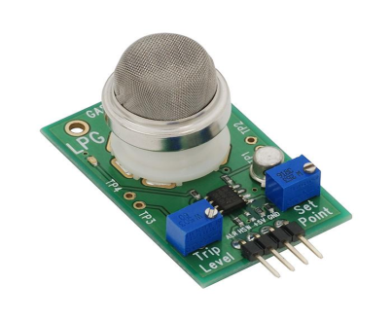
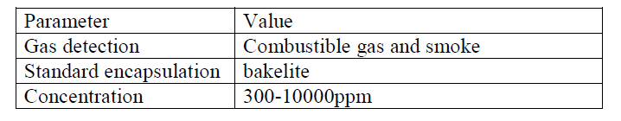
Gas Sensor
Gas Sensor MQ2
-- Gas Sensor is also known has Smoke Sensor.
-- Sensitive material of MQ-2 gas sensor is SnO2 (Tin Dioxide), which
is lower conductivity in clean air.
-- When the target combustible gas exist, The sensor’s conductivity
is more higher along with the gas concentration rising.
-- Please use simple electro circuit, Convert change of conductivity
to correspond output signal of gas concentration.
Features
-- Good sensitivity to Combustible gas in wide range.
-- High sensitivity to LPG, Propane and Hydrogen.
-- Long life and low cost.
-- Simple drive circuit.
Specifications

Slide 18
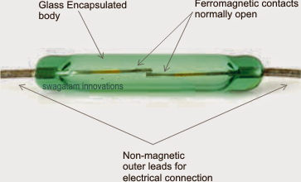
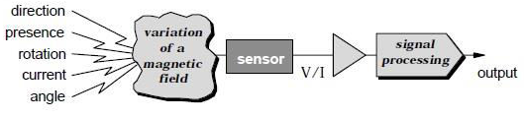
Level Sensor
What is Level Sensor?
-- Level Sensor is also known has Magnetic Sensor.
-- The Sensors, transducers which uses the changes in magnetic field for
their operations.
-- Used to measure the currents, speed, position and Displacement.
-- As the conventional sensors, Magnetic sensor does not give output
parameters directly.
-- Signal processing is required for desired output.
Working of Magnetic Sensor

Slide 19
PIR Sensor
What is PIR Sensor?
-- PIR sensor stands for passive infrared sensor.
-- A passive infrared sensor (PIR sensor) is an electronic sensor that
measures infrared (IR) light radiating from objects in its field of
view.
-- They are most often used in PIR based motion detectors.
-- All objects with a temperature above absolute zero emit heat energy in
the form of radiation.
-- Usually this radiation is invisible to the human eye because it radiates
at infrared wavelengths, but it can be detected by electronic devices
designed for such a purpose.
-- The term passive in this instance refers to the fact that PIR devices do
not generate or radiate any energy for detection purposes.
-- They work entirely by detecting the energy given off by other objects.
-- PIR sensors don't detect or measure "heat"; instead they detect the
infrared radiation emitted or reflected from an object.

Slide 20
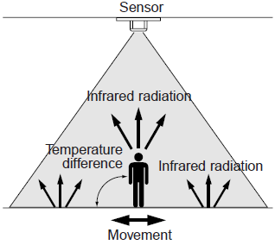
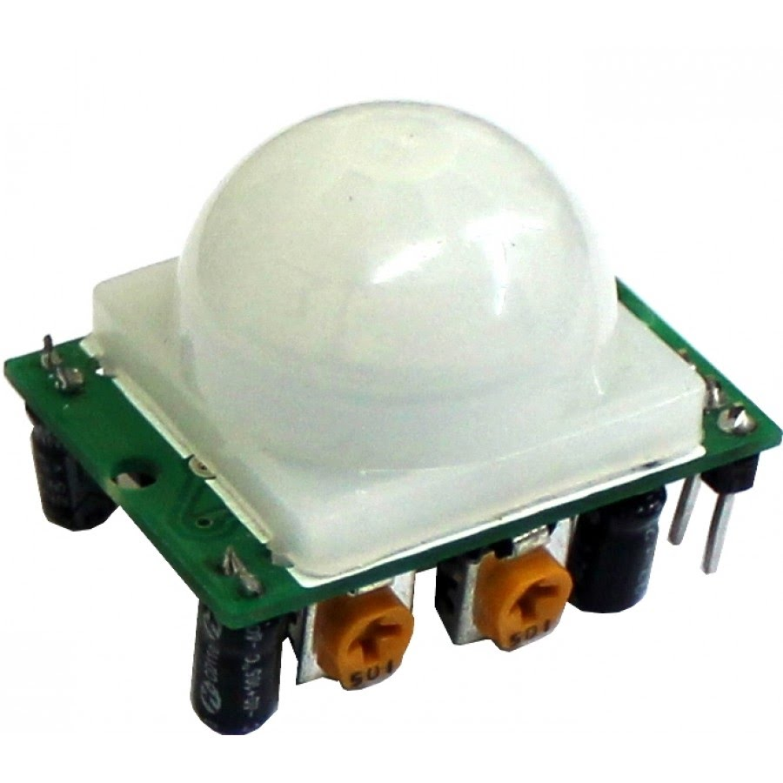
Working of PIR Sensor
PIR 325 Sensor

Slide 21
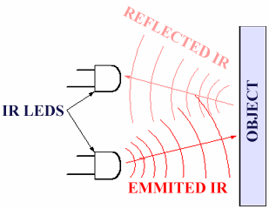
IR Sensor
What is IR Sensor?
-- IR sensor stands for infrared sensor.
-- An infrared sensor is an electronic device, that emits in order to sense
some aspects of the surroundings.
-- An IR Sensor can measure the heat of an object as well as detects the
motion.
-- These types of sensors measures only infrared radiation, rather than
emitting it that is called as a passive IR sensor.
-- Usually in the infrared spectrum, all the objects radiate some form of
thermal radiations.
-- These types of radiations are invisible to our eyes, that can be detected by
an infrared sensor.
-- The emitter is simply an IR LED (Light Emitting Diode) and the detector
is simply an IR photodiode which is sensitive to IR light of the same
wavelength as that emitted by the IR LED.
-- When IR light falls on the photodiode, The resistances and these output
voltages, change in proportion to the magnitude of the IR light received.

Slide 22
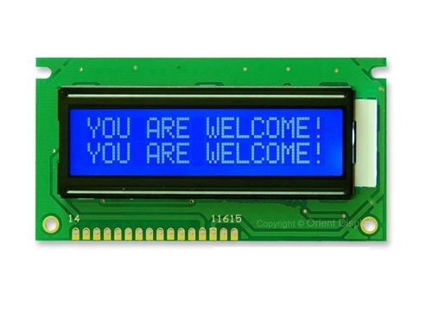
LCD Display
Introduction of LCD Display
-- LCD stands for Liquid Crystal Display.
-- Mostly used for Display of Message.
-- Highly user interactive.
-- We are using 16x2 character LCD.
-- 16x2 LCD means max 16 characters per line can be displayed and
there are 2 lines.
-- Single character is displayed in 5x7 pixel matrix.
Features of LCD Display
-- 5 x 8 dots with cursor.
-- Built in controller (KS 0066 or Equivalent).
-- + 5V power supply (Also available for + 3V).
-- 1/16 duty cycle.
-- B/L to be driven by pin 1, pin 2 or pin 15, pin 16 or A.K (LED).
-- N.V. optional for + 3V power supply.

Slide 23
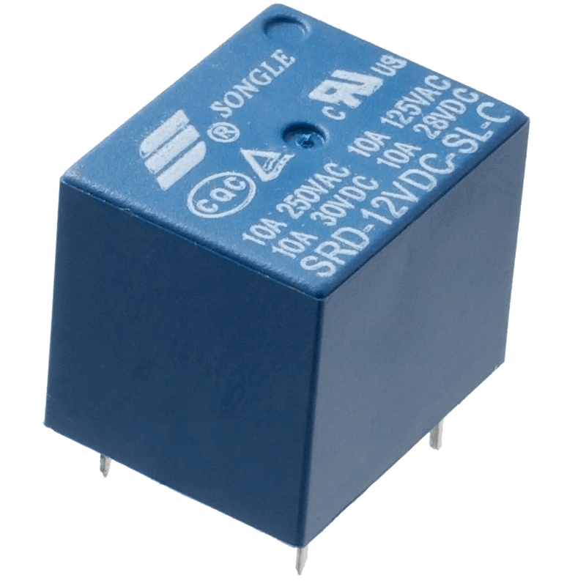
ULN2003 Relay Driver
Introduction of ULN2003 Relay Driver
-- A relay is an electrically operated switch.
-- Many relays use an electromagnet to mechanically operate a switch,
but other operating principles are also used, such as solid-state relays.
-- Relays are used where it is necessary to control a circuit by a low power
signal (with complete electrical isolation between control and controlled
circuits), or where several circuits must be controlled by one signal.
-- The first relays were used in long distance telegraph circuits as amplifiers:
they repeated the signal coming in from one circuit and re-transmitted it
on another circuit.
-- Relays were used extensively in telephone exchanges and early computers
to perform logical operations.

Slide 24
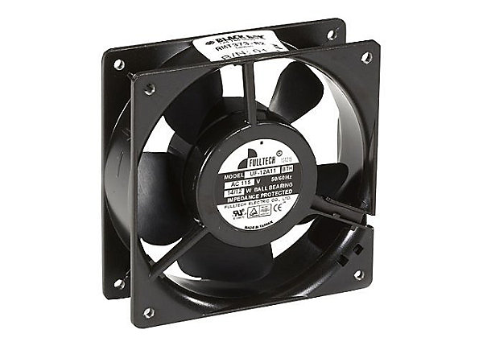
Cooling Fan
Introduction of Cooling Fan
-- Cooling fan is used regulate the device temperature.
-- To remove excess heat from the device.
Cooling System
-- An automobile's cooling system is the collection of parts and
substances (coolants) that work together to maintain the engine's
temperature at optimal levels.
-- Comprising many different components such as coolant, a thermostat
etc.
-- The system enables smooth and efficient functioning of the device at
the same time protecting it from damage.
-- An automotive cooling system must perform several functions
1. Remove excess heat from the device.
2. Maintain a consist device temperature.

Slide 25
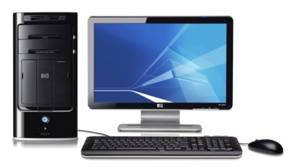
Personal Computer (PC)
What is a PC?
-- A personal computer (PC) is any general-purpose computer whose size,
capabilities, and original sales price make it useful for individuals.
-- which is intended to be operated directly by an end user, with no
intervening computer operator.
-- May be a desktop computer, a laptop, tablet PC a handheld PC (also
called palmtop) or an Apple Mac or itouch type product.
Uses of a PC
-- Word processing programs are used to type, correct, rearrange, or
delete text in letters, memos, reports, and school assignments.
-- Spreadsheet programs enable individuals to prepare tables easily. The
users of such programs establish rules for handling large groups of
numbers.
-- Database programs allow a computer to store large amounts of data
(information) in a systematic way.
-- Communication programs connect a personal computer to other
computers. People can thereby exchange information with one another
via their personal computers.
-- Other programs include recreational and educational programs for
playing games, composing and hearing music, and learning a variety of
subjects.

Slide 26
L293D Motor Driver
What is L293D Motor Driver ?
-- The L293 and L293D are quadruple high-current half-H drivers.
-- The L293 is designed to provide bidirectional drive currents of up to
1 A at voltages from 4.5 V to 36 V.
-- The L293D is designed to provide bidirectional drive currents of up
to 600-mA at voltages from 4.5 V to 36 V.
-- L293 is quadruple half-H driver i.e. in L293 all four input- output
lines are independent.
-- Output current per channel = 1A for L293. Hence, heat sink is
provided in L293.
-- Protective Diodes against back EMF are provided internally in
L293D.

Slide 27
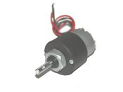
DC Motor
Introduction of DC Motor
-- It is a low cost DC motor suitable for most robotic and general
applications.
-- It has a output shaft with a hole for easy mounting of wheels or
pulleys.
-- Input Voltage: 6-12 V.
-- Stall Current: 500 - 600 mA.
-- Shaft length: 2.4 cm.
-- DC Motor has100 rpm (rotation per minute).

Slide 28
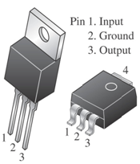
Voltage Regulator (7805)
Introduction of Voltage Regulator (7805)
-- 7805 is a voltage regulator integrated circuit.
-- The voltage regulator IC maintains the output voltage at a constant
value.
-- It provides +5V regulated power supply.
-- Two basic categories of voltage regulation are:
1. line regulation
2. load regulation
1. line regulation: The purpose of line regulation is to maintain a
nearly constant output voltage when the input voltage varies.
2. load regulation : The purpose of load regulation is to maintain a
nearly constant output voltage when the load varies.

Slide 29
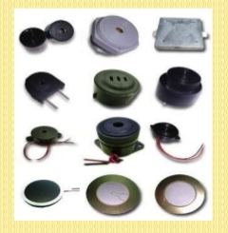
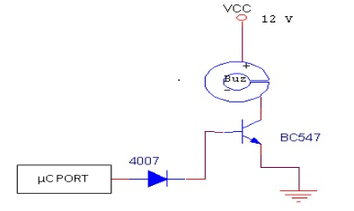
Buzzer
-- The buzzer is an output transducers converting electrical energy to
sound.
-- A buzzer is a signalling device, usually electronic, typically used in
automobiles, household appliances, industrial appliances.
-- They contain an internal oscillator to produce the sound which is set
at about 400Hz for buzzers.
-- Buzzers have a voltage rating but it is only approximate, for example
6V and 12V buzzers can be used with a 9V supply. Their typical
current is about 25mA.
-- Buzzers must be connected the right way round, their red lead is
positive (+).
What is Buzzer?

Slide 30


Slide 31


